Slide 1
Alperen Gündogan
Highlights

Slide 2
Education
Technical University of Munich, DE (2017-2020)
M. Sc. in Communication Engineering
High honors
DAAD Scholarship
Istanbul Technical University, TR (2012 - 2017)
B. Sc. in Electronics and Communication Engineering
High honors
Technical University of Ostrava, CZ (2015 - 2016)

Slide 3
Experience
Nomor Research (Apr 18 - July 20)
Working Student (Apr 18 – Aug 19)
Implementation of the latest 5G/NR standards into the 5G system simulator.
Internship (Aug 18 – Oct 18)
Design and implementation of 5G-V2X Communication
Protocol Stack design(PHY, MAC, RLC, PDCP, RRC layers) for V2X.
Master Thesis Project (Aug 19 – Mar 20)
Software/Research Engineer (Apr 20 – July 20)
Developing system and link-level standard-compliant simulation tools. Participating on research activities and actively taking part in 3GPP RAN1 standardization process.
Simulation automation
Docker orchestration.
Distributed job queue.

Slide 4
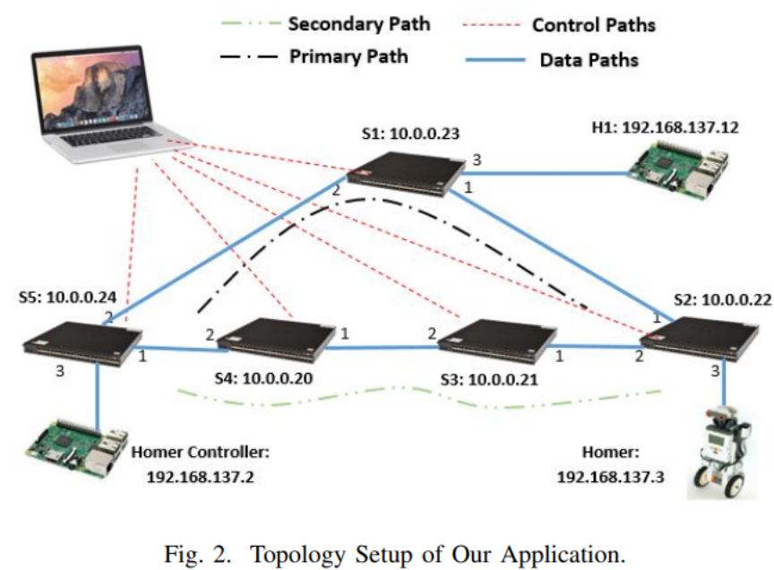
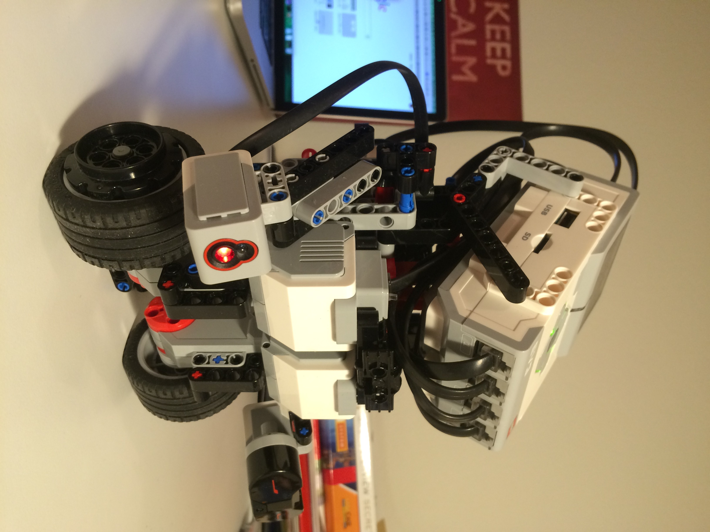
Projects
Software Defined Networks (Summer 18)
Measurement-based QoS mechanisms
Source: https://github.com/gundoganalperen/
Notes:
The status and load on the network is measured live and the sensitive applications are rerouted in order to satisfy their QoS requirements

Slide 5
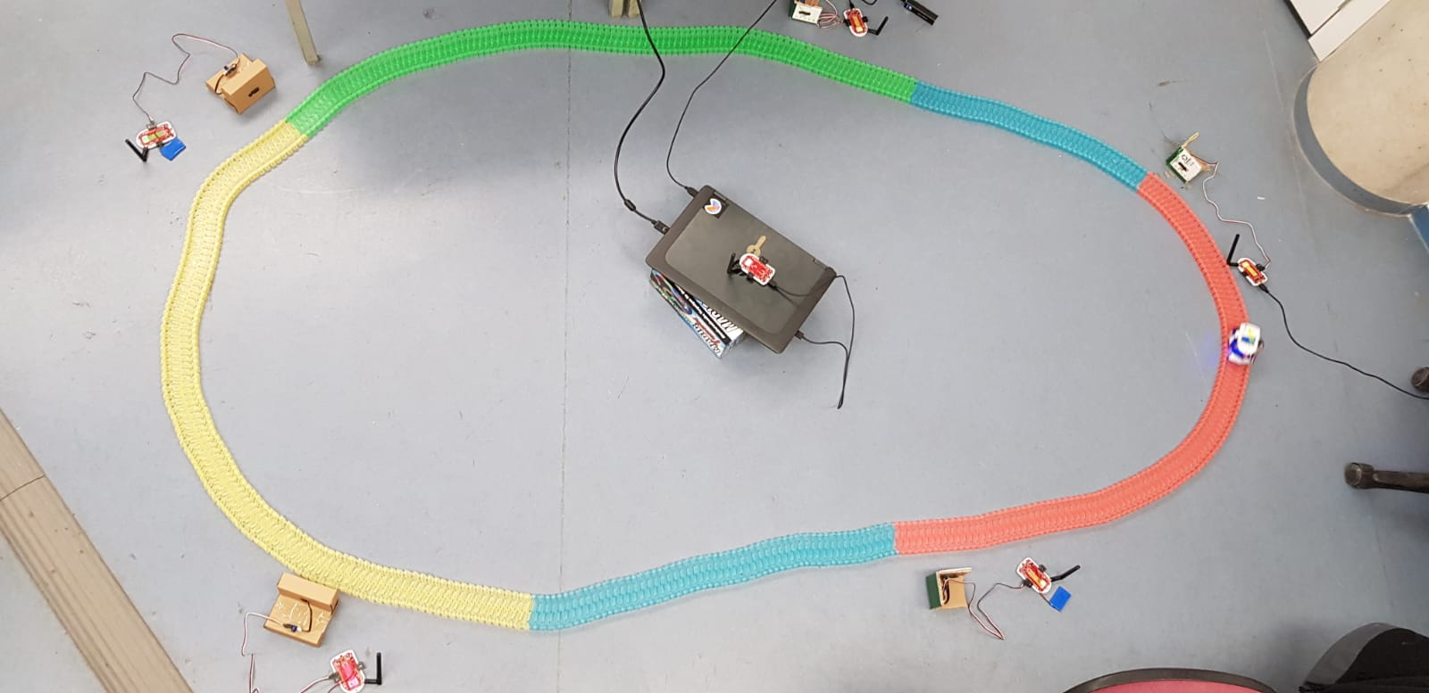
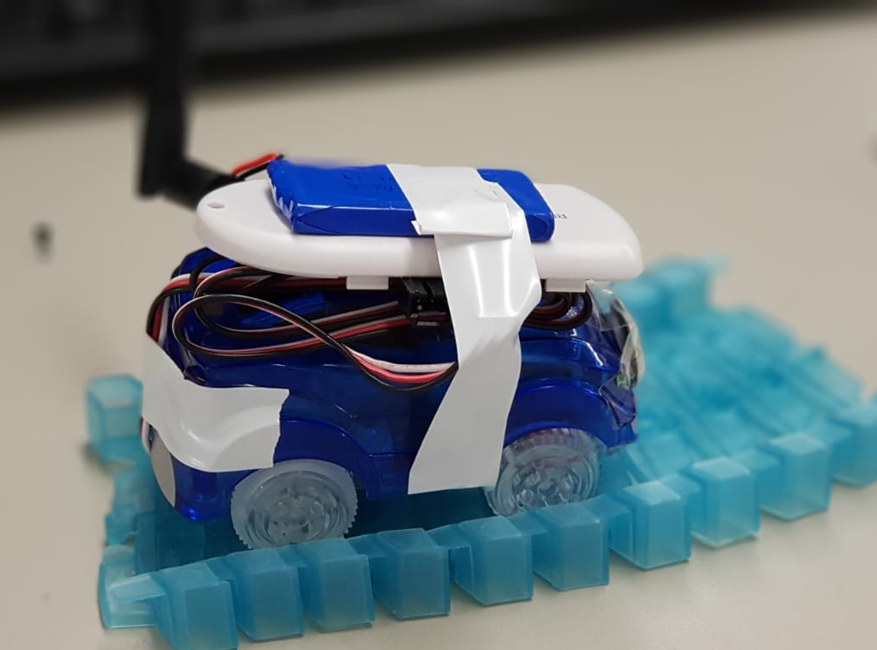
Projects
Wireless Sensor Networks (Winter 18)
Intelligent Transportation System with Wireless Sensor Networks
Source: https://github.com/gundoganalperen/
Notes:
The status and load on the network is measured live and the sensitive applications are rerouted in order to satisfy their QoS requirements

Slide 6
Projects
Research Proposal
Deep Reinforcement Learning based Resource Management for Cellular Vehicle-to-Vehicle Communication(C-V2V)
Training
Machine Learning for Communications
Approximate Dynamic Programming and Reinforcement Learning
Applied Reinforcement Learning
Neural Networks and Deep Learning (Coursera)
Improving Deep Neural Networks: Hyperparameter tuning, Regularization and Optimization (Coursera)
Notes:
The status and load on the network is measured live and the sensitive applications are rerouted in order to satisfy their QoS requirements

Slide 7
Projects
Applied Reinforcement Learning
LIDAR based Obstacle Avoidance with Reinforcement Learning using Turtlebot
Source: https://github.com/gundoganalperen/
Notes:
Study of different reinforcement learning algorithms and techniques in the context of obstacle avoidanceproblem and tests with real turtlebot

Slide 8
Master Thesis
Deep Reinforcement Learning based Resource Management for Cellular Vehicle-to-Vehicle Communication(C-V2V)
Autonomous resource allocation in the absence of a base station. Each vehicle is a learning agent.
Goal: Perform joint/cooperative behavior in a distributed fashion to utilize packet reception ratio.
Research Status
Workshop “Machine learning in the context of communication networks” at TUM (21.02.2020)
https://mlkuvs.lkn.ei.tum.de
Mobihoc 2020 (submitted)
Expected journal: IEEE Transactions on vehicular communication
Resource 1
Resource 2
Resource 3
Resource 4
Resource 5
Notes:
The status and load on the network is measured live and the sensitive applications are rerouted in order to satisfy their QoS requirements

Slide 9
Notes:
The status and load on the network is measured live and the sensitive applications are rerouted in order to satisfy their QoS requirements

Slide 10

Questions?
Notes:
The status and load on the network is measured live and the sensitive applications are rerouted in order to satisfy their QoS requirements

